Slide 1
Open-domain Knowledge Extraction
Niranjan Balasubramanian
University of Washington

Slide 2
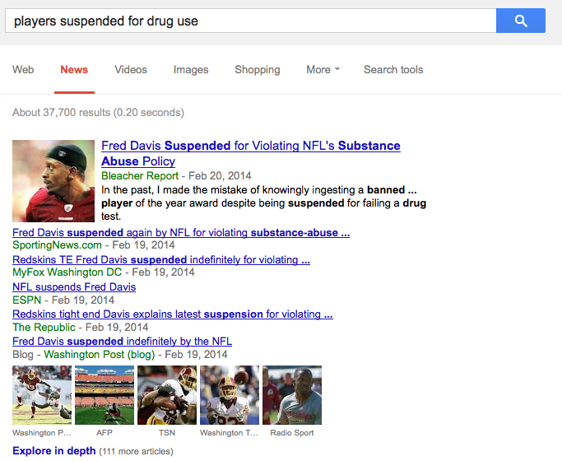
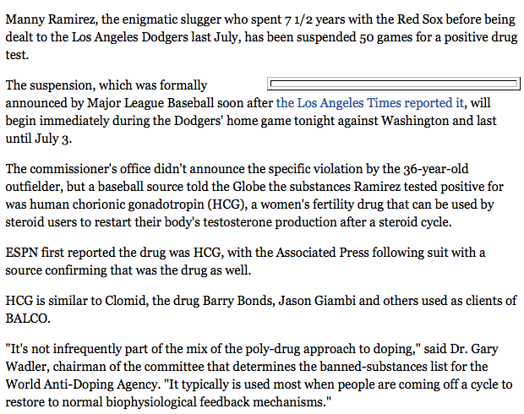
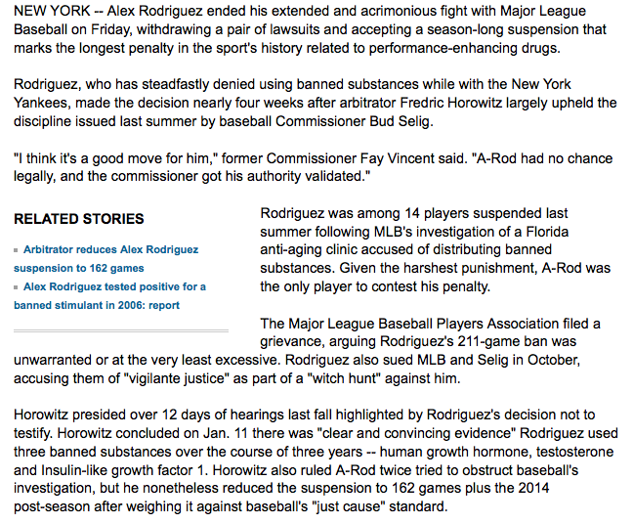

Why extract knowledge?
Information overload
Pass 4th Grade Science Exams
Notes:
Here are two reasons why you should care about knowledge extraction.
Let me start with Information overload.

Slide 3
Information Overload
Find information about players suspended for drug use
Salient information in a structured format.
Notes:
Suppose you want to find some information about players suspended for drug use.
Instead of having to read through all documents that you would get from a search engine,
It would be convenient if you had all salient information in a structured form.

Slide 4
Information Extraction
Find information about players suspended for drug use
Extractor
Salient information in a structured format.
Need knowledge about events!
Manual authoring is not a scalable option.
Notes:
Information extraction systems aim to do just that.
However, they often lack a notion of salience.
To extract useful information in cases like these, you need some knowledge about what a typical suspension event looks like.

Slide 5
Passing 4th Grade Science Exam
Human-level performance on intelligence tasks.
Which of the following is the best conductor of electricity?
(A) plastic cup (B) wooden bat (C) rubber boat (D) iron nail
Retrieval and matching alone aren’t adequate!
Need knowledge that can be used for inference.
Manual authoring doesn’t scale.
Notes:
Another key motivation is the AI vision of achieving (if not exceeding) human-level performance on intelligence tasks.
If you are building a QA system that aims to pass 4th grade exam, you will run into questions like these, retrieval and matching techniques
alone aren’t adequate.
You need several forms of knowledge, especially in a form that can be used for inference.
Maybe I have convinced you that knowledge extraction is an useful pursuit.

Slide 6
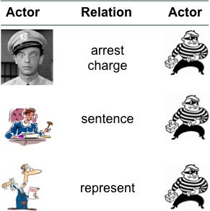
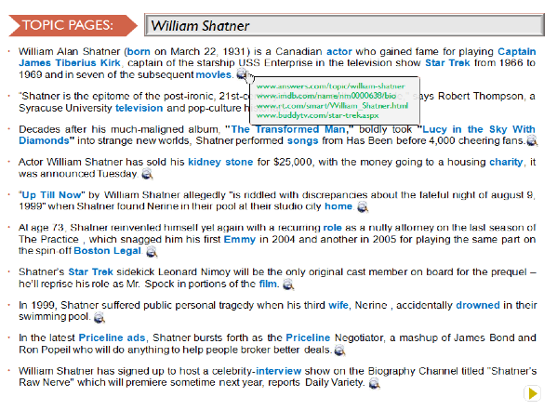
This Talk
1) Generating Coherent Event Schemas
Build models of open-domain events.
2) Generating Topic Pages
Aggregate and organize information about entities.
3) Question Answering
Answer 4th grade science exams.
Notes:
In this talk I am going to talk about three projects that broadly relate to knowledge extraction.
Extracting knowledge about events to serve as models of open-domain events.
Extracting knowledge about entities to automatically generate wikipedia-like pages.
Extracting and reasoning with knowledge for answering grade science exams.
I will spend most time on event schemas, a little bit of time on topic pages and I would like to mention on-going work in 3 and conclude with future directions.

Slide 7
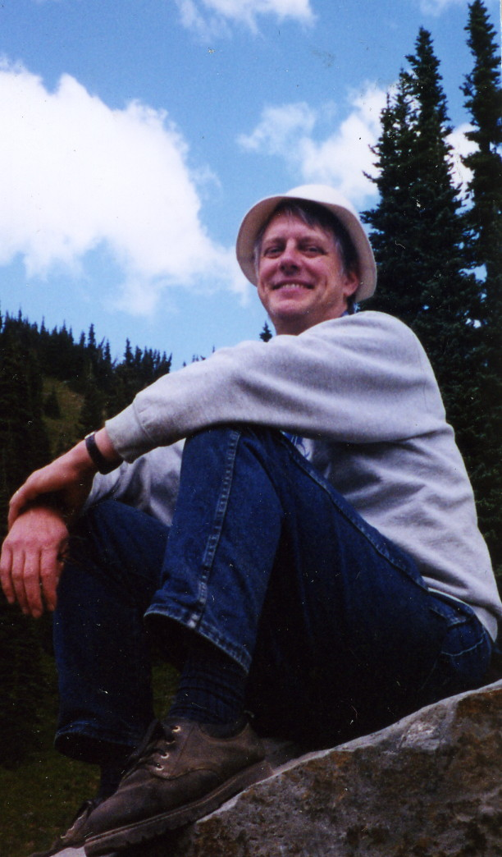
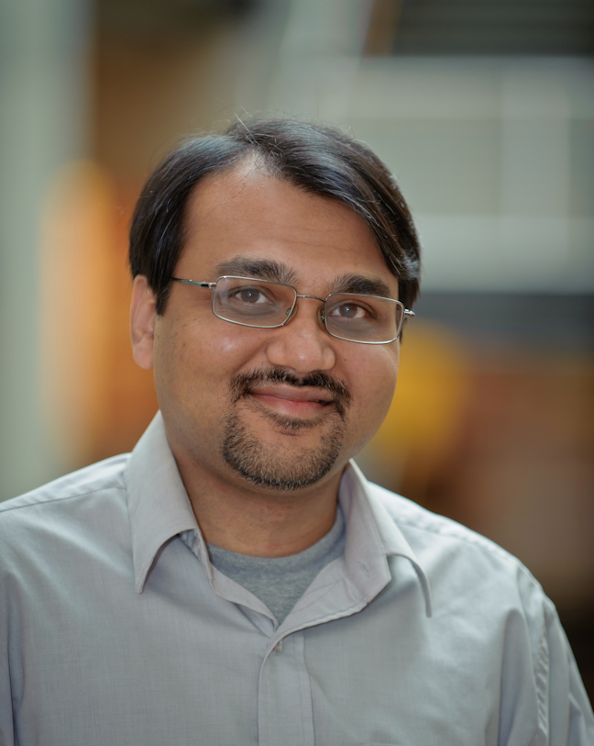
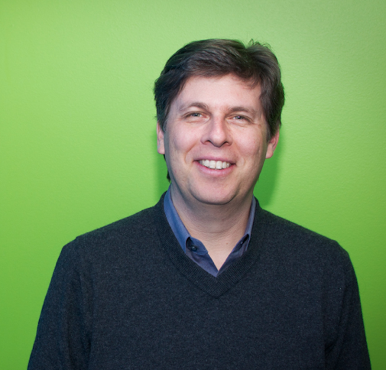
Generating Coherent Event Schemas
Rel-grams and Event Schemas
[AKBC-WEKEX 2012], [EMNLP 2013]
Stephen Soderland
University of Washington
Mausam
Indian Institute of Technology Delhi
Oren Etzioni
Allen Institute for Artificial Intelligence
Notes:
In this first part I am going to talk about joint work with Stephen Soderland, Mausam and Oren Etzioni.

Slide 8
Motivation
Find information about players suspended for drug use
Notes:
Getting back to the use case…
We are looking to find information about players suspended for drug use.
We get a bunch of web pages from a search engine. About 37000 for this one.

Slide 9
Motivation
Find information about players suspended for drug use
1) Manny Ramirez was suspended for 50 games
2) Ramirez had testosterone from an artificial source
3) Ramirez used the drug hCG
4) Ramirez was suspended by Major League Baseball
Manny Ramirez joined a growing lineup of All-Stars linked to drugs Thursday, with the dreadlocked slugger banished for 50 games by a sport that cannot shake free from scandal.
The Los Angeles Dodgers star said he did not take steroids and was prescribed medication by a doctor that contained a banned substance.
"It's a dark day for baseball and certainly for this organization," Dodgers general manager Ned Colletti told reporters on the field at Dodger Stadium. "This organization will never condone anything that isn't clean."
The commissioner's office didn't announce the specific violation by the 36-year-old outfielder, who apologized to the Dodgers and fans for "this whole situation."
However, testing by Major League Baseball showed that Ramirez had testosterone in his body that was not natural and came from an artificial source, two people with knowledge of the case told ESPN's Mark Fainaru-Wada and T.J. Quinn. The sources said that in addition to the artificial testosterone, Ramirez was identified as using the female fertility drug human chorionic gonadotropin, or hCG.
The sources said Ramirez was suspended for using hCG because baseball had documentation to prove his use of the drug. A Major League Baseball source said Ramirez's representatives indicated they would fight a suspension for using artificial testosterone.
…
Notes:
Let’s inspect one document here.
This document is about Manny Ramirez suspended for using hCG and having high levels of artificially generated testosterone.

Slide 10
Entity Extraction
Extract (named) entities mentioned in text.
Manny Ramirez joined a growing lineup of All-Stars linked to drugs Thursday, with the dreadlocked slugger banished for 50 games by a sport that cannot shake free from scandal.
The Los Angeles Dodgers star said he did not take steroids and was prescribed medication by a doctor that contained a banned substance.
"It's a dark day for baseball and certainly for this organization," Dodgers general manager Ned Colletti told reporters on the field at Dodger Stadium. "This organization will never condone anything that isn't clean."
The commissioner's office didn't announce the specific violation by the 36-year-old outfielder, who apologized to the Dodgers and fans for "this whole situation."
However, testing by Major League Baseball showed that Ramirez had testosterone in his body that was not natural and came from an artificial source, two people with knowledge of the case told ESPN's Mark Fainaru-Wada and T.J. Quinn. The sources said that in addition to the artificial testosterone, Ramirez was identified as using the female fertility drug human chorionic gonadotropin, or hCG.
The sources said Ramirez was suspended for using hCG because baseball had documentation to prove his use of the drug. A Major League Baseball source said Ramirez's representatives indicated they would fight a suspension for using artificial testosterone.
Ramirez, in a statement issued by the players' union, said: "Recently, I saw a physician for a personal health issue. He gave me a medication, not a steroid, which he thought was OK to give me.
…
Persons
Manny Ramirez
Ramirez
Ned Colletti
Mark Fainaru-Wada
T.J.Quinn
Organizations
Los Angeles Dodgers
Dodgers
ESPN
Major League Baseball
players’ union
Location
Dodger Stadium
Date
Thursday
Need relationships between entities!
Notes:
Let’s inspect what current information extraction systems can give us.
Entity extraction systems are typically the first stage in an IE system, where you can identify named entities in the document.
Not terribly useful by themselves. We need relationships between entities to capture useful information.

Slide 11
Traditional Information Extraction
Extract semantic relationships between entities.
Manny Ramirez joined a growing lineup of All-Stars linked to drugs Thursday, with the dreadlocked slugger banished for 50 games by a sport that cannot shake free from scandal.
The Los Angeles Dodgers star said he did not take steroids and was prescribed medication by a doctor that contained a banned substance.
"It's a dark day for baseball and certainly for this organization," Dodgers general manager Ned Colletti told reporters on the field at Dodger Stadium. "This organization will never condone anything that isn't clean."
The commissioner's office didn't announce the specific violation by the 36-year-old outfielder, who apologized to the Dodgers and fans for "this whole situation."
However, testing by Major League Baseball showed that Ramirez had testosterone in his body that was not natural and came from an artificial source, two people with knowledge of the case told ESPN's Mark Fainaru-Wada and T.J. Quinn. The sources said that in addition to the artificial testosterone, Ramirez was identified as using the female fertility drug human chorionic gonadotropin, or hCG.
The sources said Ramirez was suspended for using hCG because baseball had documentation to prove his use of the drug. A Major League Baseball source said Ramirez's representatives indicated they would fight a suspension for using artificial testosterone.
Ramirez, in a statement issued by the players' union, said: "Recently, I saw a physician for a personal health issue. He gave me a medication, not a steroid, which he thought was OK to give me.
…
Traditional IE
Employee(Ned Colletti, Dodgers)
Employee(Mark Fainaru-Wada, ESPN)
Employee(TJ Quinn, ESPN)
Located-at(Ned Colletti, Dodger’s stadium)
…
Relations need to be hand-specified!
Notes:
Traditional Information Extraction systems aim to identify semantic relationships between entities such as “Employed by” “located at” etc.
The trouble is we have to hand-specify these relations a-priori. The approach does not scale well if we want to switch to another domain.

Slide 12
Open Information Extraction
Extract open-domain relationships.
(Argument1, Relation, Argument2)
Manny Ramirez joined a growing lineup of All-Stars linked to drugs Thursday, with the dreadlocked slugger banished for 50 games by a sport that cannot shake free from scandal.
Open IE
(Manny Ramirez, joined, a growing lineup of All-stars)
(dreadlocked slugger, was banished for, 50 games)
(dreadlocked slugger, was banished by, a sport)
Notes:
Open Information extraction aims to address the scale issue.
It can identify open-domain relationships mentioned in text.
Typically, relations are expressed as(Arg1, Relation, Arg2) formatted triple.
For example, this sentence yields three relation triples.
This scales well and can generate relations in many domains.

Slide 13
What can Information Extraction do?
Extract open-domain relationships.
Argument 1 | Relation | Argument 2(s)
Manny Ramirez | joined | a growing lineup of All-Stars
the dreadlocked slugger | was banished by | a sport that cannot shake free from scandal
the dreadlocked slugger | was banished for | 50 games
Los Angeles Dodgers star | said of | he
he | did was prescribed medication by | a doctor that contained a banned substance
he | did not take | steroids
he | did was prescribed | medication
Dodgers general manager Ned Colletti | told reporters on | the field
Dodgers general manager Ned Colletti | told reporters at | Dodger Stadium
reporters | was told on | the field
Dodgers general manager Ned Colletti | told | reporters
This organization | will never condone | anything that is n't clean
reporters | was told at | Dodger Stadium
Ned Colletti | was manager of | Dodgers
It | 's certainly | a dark day
The commissioner 's office | didn't announce specific violation by | the 36-year-old outfielder… this whole situation
the 36-year-old outfielder | apologized to | the Dodgers and fans
the specific violation | did n't announce by | the 36-year-old outfielder …this whole situation
The commissioner 's office | did n't announce | the specific violation
Ramirez | had testosterone in | his body that was not natural
Ramirez | was identified in | addition
testosterone | was had in | …came from an artificial source
his body that was not natural | came from | an artificial source
Ramirez | had | testosterone
two people | told | ESPN 's Mark Fainaru-Wada
testing | However showed | Ramirez
Ramirez | had testosterone | two people
they | would fight | a suspension
Too many relations!
Notes:
However, it extracts too many relationships. Open Ie will output all relations it finds in texts.

Slide 14
Event Extraction
What is missing?
Salience – Many actors and relations are not central.
ESPN, Mark Fainaru-Wade, reporters.
joined, told, was manager of, will never condone
Structure – beyond the binary relations between entities.
Some relations belong together
Order in which events happened.
Implicit relations – beyond what is stated in text.
Ramirez was a Dodger.
Ramirez failed a drug test.
Major League Baseball suspended Ramirez.
This talk.
Future work.
Notes:
What is missing then?
There is no notion of salience – many actors and relations are not central to the event.
There is no structure beyond the binary relationships.
Moreover, some of the relations are not explicitly stated in the text.
For example, Ramirez was a dodger.

Slide 15
Event Extraction
What are the salient pieces of information in this document?
1) Manny Ramirez was suspended for 50 games
2) Ramirez had testosterone from an artificial source
3) Ramirez used the drug hCG
4) Ramirez was suspended by Major League Baseball
Manny Ramirez joined a growing lineup of All-Stars linked to drugs Thursday, with the dreadlocked slugger banished for 50 games by a sport that cannot shake free from scandal.
The Los Angeles Dodgers star said he did not take steroids and was prescribed medication by a doctor that contained a banned substance.
"It's a dark day for baseball and certainly for this organization," Dodgers general manager Ned Colletti told reporters on the field at Dodger Stadium. "This organization will never condone anything that isn't clean."
The commissioner's office didn't announce the specific violation by the 36-year-old outfielder, who apologized to the Dodgers and fans for "this whole situation."
However, testing by Major League Baseball showed that Ramirez had testosterone in his body that was not natural and came from an artificial source, two people with knowledge of the case told ESPN's Mark Fainaru-Wada and T.J. Quinn. The sources said that in addition to the artificial testosterone, Ramirez was identified as using the female fertility drug human chorionic gonadotropin, or hCG.
The sources said Ramirez was suspended for using hCG because baseball had documentation to prove his use of the drug. A Major League Baseball source said Ramirez's representatives indicated they would fight a suspension for using artificial testosterone.
Ramirez, in a statement issued by the players' union, said: "Recently, I saw a physician for a personal health issue. He gave me a medication, not a steroid, which he thought was OK to give me.
…
Suspension Schema
Actors Roles
Test Drug test that was administered
Player Person who fails the test
Team Player’s team
Organization Organization that suspends the player
Drug Drug used by the player
Duration Time for which the player is suspended

Slide 16
Event Extraction
What are the salient pieces of information in this document?
Manny Ramirez joined a growing lineup of All-Stars linked to drugs Thursday, with the dreadlocked slugger banished for 50 games by a sport that cannot shake free from scandal.
The Los Angeles Dodgers star said he did not take steroids and was prescribed medication by a doctor that contained a banned substance.
"It's a dark day for baseball and certainly for this organization," Dodgers general manager Ned Colletti told reporters on the field at Dodger Stadium. "This organization will never condone anything that isn't clean."
The commissioner's office didn't announce the specific violation by the 36-year-old outfielder, who apologized to the Dodgers and fans for "this whole situation."
However, testing by Major League Baseball showed that Ramirez had testosterone in his body that was not natural and came from an artificial source, two people with knowledge of the case told ESPN's Mark Fainaru-Wada and T.J. Quinn. The sources said that in addition to the artificial testosterone, Ramirez was identified as using the female fertility drug human chorionic gonadotropin, or hCG.
The sources said Ramirez was suspended for using hCG because baseball had documentation to prove his use of the drug. A Major League Baseball source said Ramirez's representatives indicated they would fight a suspension for using artificial testosterone.
Ramirez, in a statement issued by the players' union, said: "Recently, I saw a physician for a personal health issue. He gave me a medication, not a steroid, which he thought was OK to give me.
…
Suspension Event
Test testosterone
Player Manny Ramirez
Team Dodgers
Organization Major League Baseball
Drug testosterone, hCG
Duration 50 games
Template
IE

Slide 17

Open-domain Event Schemas
How to generate schemas for arbitrary open-domain events?
Input:
News Texts
Output:
Event Schemas
bombing
Test Drug test that was administered
Player Person who fails the test
Team Player’s team
Organization Organization that suspends the player
Drug Drug used by the player
Duration Time for which the player is suspended
Lawsuit
Test Drug test that was administered
Player Person who fails the test
Team Player’s team
Organization Organization that suspends the player
Drug Drug used by the player
Duration Time for which the player is suspended
Arrest
Test Drug test that was administered
Player Person who fails the test
Team Player’s team
Organization Organization that suspends the player
Drug Drug used by the player
Duration Time for which the player is suspended
Suspension
Actors Roles
Test Drug test that was administered
Player Person who fails the test
Team Player’s team
Organization Organization that suspends the player
Drug Drug used by the player
Duration Time for which the player is suspended

Slide 18
Event Schemas
A set of actors and the roles they participate in.
Actor
Relation
Actor
[person]
Murray,
Morgan,
...
A1
A2
[none]
test
failed
A1
A3
[time]
season, week, month,,…
suspended for
1) Not labeled actors.
2) Roles via relations.
A1
A4
[substance] [drug]
cocaine, drug, gasoline, …
used
A1
A5
[game] [activity]
violation, game, abuse, …
suspended for
A1
A6
[location]
desert, Simsbury, Albany, …
was in
A1
A7
[person] [organization]
Fitch, NBA, Bud Selig, …
suspended by
Notes:
Many actors and useful relations.

Slide 19
Prior Work
Manually authored templates don’t scale.
Laborious
Limited domains.
Automatic methods have coherence issues.
Mix distinct events.
Mix distinct actors.
Generate coherent event schemas at scale.
Notes:
Chambers and Jurafsky in their seminal work showed an automatic method.
Chambers
and one other recent work has followed up with probabilistic induction

Slide 20
In context
Open Event Extraction
Acquisition
Research study
Legislation
[EMNLP 2013]
Open Relation Extraction
is an album by,
has a Ph.D. in,
made a promise to,…
Fine-grained
Actor, Architect, …
Airline, Sports team, …
City, Country, mountain, ….
Template-based Extraction
Bombing
Arrest
Arson
…
Traditional IE
acquired-by
employed-by
president-of
…
Named-entities
Person
Organization
Location
Misc.
Entities
Relations
Events
Notes:
Well studied problem.
Several successful systems and products exist.
Mostly supervised methods.

Slide 21
Our Solution
Use Open Information Extraction to identify salient relations.

Slide 22
Extracting Knowledge About Events
Intuitions:
Facts frequently co-mentioned in texts are related to each other.
A high proportion indicate entailment in the real world.
Information about types of events can be generalized from specific mentions.
Open IE relations capture essential information about events.

Slide 23
Extracting Knowledge About Events
Hypothesis:
Frequently co-occurring relations capture coherent knowledge about events.
John was arrested by police … They charged him with armed robbery
Ramirez failed a drug test …He was suspended for 50 games
A bomb exploded in a market… The group claimed responsibility.
Democrats favored the bill…overwhelmingly opposed by the republicans.

Slide 24
Rel-grams
A bi-gram model of relation co-occurrence.
How likely are we to see relation T’ in the vicinity of T?
Probability of seeing T’ in the vicinity of T
Delta-smoothed for sparse events.
Importance decays with length of window
Normalized to stay within (0, 1)
Notes:
We formalize this intuition using a simple bi-gram co-occurrence model of relations.

Slide 25
Extracting Relations using Open IE
Open Information Extraction can handle open-domain relations.
Scales easily to large collections.
(person, is arrested by, police) (person, is charged by, police)
(person, failed, a drug test) (person, is suspended for, violation)
(bomb, explode in, a location) (group, claimed, responsibility)
(democrats, favored, a bill) (republicans, opposed, the bill)

Slide 26
Representing Relations
Text:
He cited a new study that was released by UCLA in 2008.
Extractions:
(He, cited, a new study)
(a new study, was released by, UCLA)
(a new study, was released in, 2008)
Normalized:
(he, cited, study)
(study, be released by, UCLA)
(study, be released in, 2008)
Generalized:
([person], cited, [activity])
([activity], be released by, [organization])
([activity], be released in, [time-unit])
Ollie [Mausam et al, 2012]
State-of-the-art open extractor.
Extract Argument Head:
10 people => people
group of passengers => passengers
France’s president => president
Assign Semantic Classes
Named entity classes
Person, Organization, Location,…
29 WordNet classes
Drug, Structure, Device, Activity, …

Slide 27
Rel-grams Tabulation
Rel-grams Tabulation
T | T’ | #1(T, T’) | #2(T, T’)
(he, cited, study) | (study, be released by, UCLA) | 1 | 2
([person], cited, [activity]) | ([activity], released by, [organization]) | 17 | 19
([person], cited, X:[activity]) | (X:[activity], released by, [organization]) | 14 | 14
… | … | … | …
(X:[person], failed, test) | (X:[person], suspended for, [activity]) | 23 | 24
(bomb, exploded in, Bhagdad) | (group, claimed, responsibility) | 1 | 7
([device], exploded in, [location]) | ([organization], claimed, responsibility) | 14 | 11

Slide 28
Rel-grams Evaluation
Manual evaluation of a sample of Top 10%
Entailment: T => T’ or T’ => T
Common Topic: Topic(T’) = Topic(T)
1) Frequently co-mentioned facts are related to each other.
2) Generalized open-domain relations carry event type information.
Notes:
Tuple validity is a problem:
Open IE is about 75% accurate.
Rel-gram the errors multiply!
Strong implication results show there is a signal here.

Slide 29
Building Schemas
T | T’ | #1(T, T’) | #2(T, T’)
(he, cited, study) | (study, be released by, UCLA) | 1 | 2
([person], cited, [activity]) | ([activity], released by, [organization]) | 17 | 19
([person], cited, X:[activity]) | (X:[activity], released by, [organization]) | 14 | 14
… | … | … | …
(X:[person], failed, test) | (X:[person], suspended for, [activity]) | 23 | 24
(bomb, exploded in, Bhagdad) | (group, claimed, responsibility) | 1 | 7
([device], exploded in, [location]) | ([organization], claimed, responsibility) | 14 | 11
bombing
Test Drug test that was administered
Player Person who fails the test
Team Player’s team
Organization Organization that suspends the player
Drug Drug used by the player
Duration Time for which the player is suspended
Lawsuit
Test Drug test that was administered
Player Person who fails the test
Team Player’s team
Organization Organization that suspends the player
Drug Drug used by the player
Duration Time for which the player is suspended
Arrest
Test Drug test that was administered
Player Person who fails the test
Team Player’s team
Organization Organization that suspends the player
Drug Drug used by the player
Duration Time for which the player is suspended
Suspension
Test Drug test that was administered
Player Person who fails the test
Team Player’s team
Organization Organization that suspends the player
Drug Drug used by the player
Duration Time for which the player is suspended

Slide 30
Building Schemas
Create a graph from Rel-grams
Nodes = Generalized tuples
Edge = Symmetric conditional probability
2. Identify seed tuples to build schemas from high connectivity nodes
3. Use Personalized PageRank to find related tuples.

Slide 31
Building Schemas
4. Take top N tuples.
Tuples | Page Rank
[person], suspended by, [org] | 1.0
[person], used, [substance] | 0.9
[person], suspended for, [activity] | 0.8
([person], failed, test) | 0.7
… | …
Ramirez, used, [substance] | 0.3
… | …
… | …

Slide 32
Building Schemas
5. Collect actor candidates from arguments.
Tuples | Page Rank
[person], suspended by, [org] | 1.0
[person], used, [substance] | 0.9
[person], suspended for, [activity] | 0.8
[person], failed, test | 0.7
… | …
Ramirez, used, [substance] | 0.3
… | …
… | …
Tuples | Page Rank
A1: [person], suspended by, A2: [org] | 1.0
A3: [person], used, A4: [substance] | 0.9
A5: [person], suspended for, A6: [activity] | 0.8
A4: [person], failed, A7:test | 0.7
… | …
A8: Ramirez, used, A9: [substance] | 0.3
… | …
… | …

Slide 33
Building Schemas
6. Merge actors
Using equality constraints.
If the participate in same roles.
7. Output top K relations.
Tuples | Page Rank
A1: [person], suspended by, A2: [org] | 1.0
A3: [person], used, A4: [substance] | 0.9
A5: [person], suspended for, A6: [activity] | 0.8
A4: [person], failed, A7:test | 0.7
… | …
A8: Ramirez, used, A9: [substance] | 0.3
… | …
… | …
Tuples | Page Rank
A1: [person], suspended by, A2: [org] | 1.0
A1: [person], used, A4: [substance] | 0.9
A1: [person], suspended for, A6: [activity] | 0.8
A1: ([person], failed, A7:test) | 0.7
… | …
A1: Ramirez, used, A4: [substance] | 0.3
… | …
… | …

Slide 34
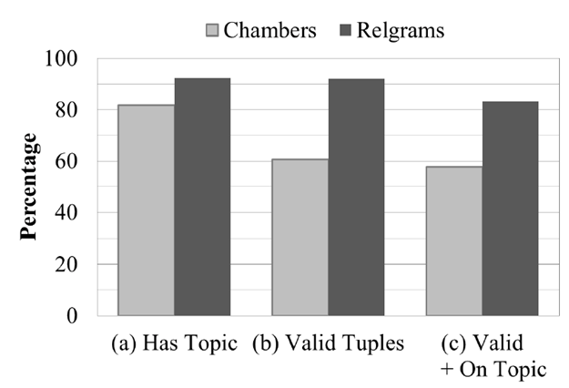
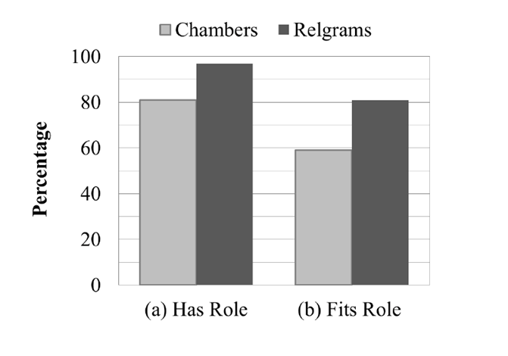
Results
More coherent sets of relations and actors!
Topic coherence
Actor coherence
Balasubramanian et al., Generating Coherent Event Schemas at Scale, EMNLP 2013

Slide 35
Mixing Distinct Events
Actor
Relation
Actor
infection
fire
A1
A2
disease
caused
disease
A2
A1
infection
fire
spread
infection
fire
A1
broke out
extinguished
A1
infection
fire
Notes:
… of infection spreading and fire spreading.
What is wrong with mixing distinct events?
Relations that don’t fit in one event.
Example: extinguishing doesn’t fit infection event.
Can result in triples that make no sense (disease, spread, fire)
There are plenty of other examples:
airlines scheduling flights,
government scheduling meetings,
nba, scheduling games
Why does this happen

Slide 36
Mixing Distinct Events
Dependency pair representation ignores useful context.
The disease broke out in Canton and spread very quickly to Sudbury.
(disease, broke out)
(disease, spread)
…
The fire broke out in the bedroom and spread quickly to the roof.
(fire, broke out)
(fire, spread)
…
Notes:
We argue that this is because the representation ignores essential context.
In this case there is important information following broke out and spread that could help keep separate these two events.
However,

Slide 37
Mixing Distinct Events
Dependency pair ignores useful context.
The disease broke out in Canton and spread very quickly to Sudbury.
(X, broke out)
(X, spread)
…
The fire broke out in the bedroom and spread quickly to the roof.
(X, broke out)
(X, spread)
…
Actor X : { fire, infection, …, }
Roles : { subj(broke out), subj(spread), …, }
Notes:
However, the pairwise representation leads the clustering algorithm to believe that the
subj of broke out is the same as the subject of spread which is fine but it also results
in clustering of the tuples from both fire and infection together.

Slide 38
Using Open IE Triples
Retains more context to reduce ambiguity in relations.
Type compatibility rules improve actor coherence.
The disease broke out in Canton and spread very quickly to Sudbury.
(X, broke out in, [location])
(X, spread to, [location])
…
The fire broke out in the bedroom and spread quickly to the roof.
(X, broke out in, [structure])
(X, spread to, [structure])
…
Notes:
Retain more context.
So we are going to use triples instead of pairs.

Slide 39
Mixing Distinct Actors: Narrative Schemas
A1
oppose
sign
approve
veto
support
pass
A2
A1
A2
bill
president
house
A1
A2
bill
measure
legislation
A1
A2
A1
A2
A1
A2
Conflates actors:
bill, president, and house.

Slide 40
Mixing Distinct Actors: Rel-grams
Carey
Anthony
Volpe
A1
veto
sign by
pass by
sign into
to sign
governor of
A2
legislation
bill
law
A2
A1
Sate senate
Senate
House
A2
A3
A1
A4
law
bill
A1
A5
Mass.
state
S. Carolina
A1
A6
Open IE provides nice benefits over SVO:
- Able to distinguish distinct actors.
- Noun mediated relations captured.

Slide 41
Summary
Take aways:
Relational co-occurrence model captures knowledge about events.
Rel-grams capture a form of entailment.
Open IE based representation improves coherence.
Future work:
Towards script like knowledge
Causality
Temporal ordering
Applications
Building extractors for Open event schemas.
Co-reference
Single-document summarization

Slide 42
This Talk
1) Generating Coherent Event Schemas
Build models of open-domain events.
2) Generating Topic Pages
Aggregate and organize information about entities.
3) Question Answering
Answer 4th grade science exams.

Slide 43
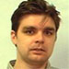
Topic Pages
[CIKM 2009], [ICSC 2010]
Silviu Cucerzan
Microsoft Research

Slide 44
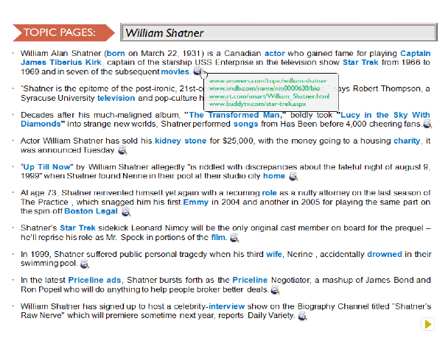
Topic Pages

Slide 45
Questions
What are the salient aspects of an entity?
How to extract information about these entities?
How to organize and present information in a coherent manner?

Slide 46
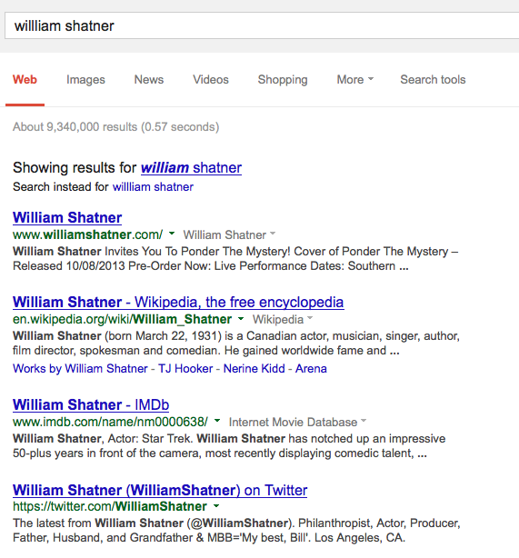
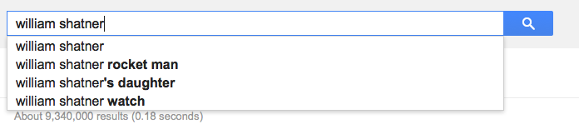
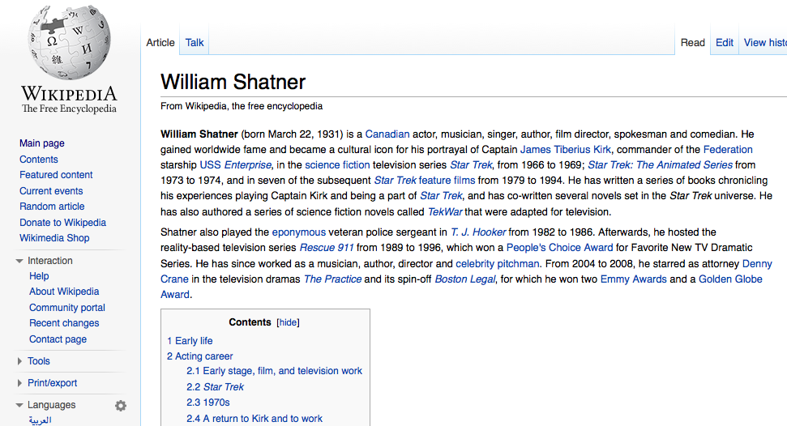
Questions
What are the salient aspects of an entity?

Slide 47
Query-log based aspect models
Query logs aggregate information needs about entities
Temporally sensitive
Complementary to information in Wikipedia

Slide 48
What are the salient aspects for an entity?
Query Logs
Extract Aspects
Retrieve
Web Docs
Extract
Relevant Sentences
Order Sentences
Britney Spears
Britney Spears weight
Britney Spears hair
Britney Spears
Britney height
…
…
Britney Spears babies
…
…
Britney Spear albums
Britney Spears age
…
…
Tom Cruise Nicole Kidman
Nicole Kidman pregnant
Nicole Kidman Keith Urban
Nicole Kidman movies Nicole Kidman United
Height
Age
Babies
Weight
Albums
Music
http://www.
Tom Cruise
pregnant
Keith Urban
United
movies
http://www.

Slide 49
Aspect Models
Direct
Explicitly queried aspects.
movie names, awards…
Related
Aspects queried for similar entities.
movies, music, albums…
senator, congressman,…
General
Aspects queried for all entities.
spouse, other relationships…
height, age, weight,…
General Aspects
Related Aspects
Specific Aspects
Born
Parents
Wife
Husband
Children
…
Movies
Films
Debut
…
Scientology
Nicole Kidman
Katie Holmes
…
Tom Cruise
Senator
Senate
President
presidential
…
Al Gore
Global warming
An inconvenient truth
Oscar
…

Slide 50
Related Aspect Models
Search Sessions
Candidate Related Topics
Johnny Depp
Pirates of the Caribbean
Johnny Depp
Nicolas Cage
Google
John Cusack
Walmart
Joe Pesci
Johnny Depp birthday
Pirates of the Carribbean
Nicolas Cage
Google
John Cusack
Walmart
Joe Pesci
….
Top Related Topics
Nicolas Cage movies
Nicholas Cage pics
…
Nicolas Cage actor
…
John Cusack
Joe Pesci
Denzel Washington
Scott Glen
Nicolas Cage
…
…
=
Johnny Depp actor
Johnny Depp pics
…
Johnny Depp movies
…

Slide 51
Retrieving and Ordering Sentences
Cover the typical relationship between topic and aspect.
Enhance aspect model with context.
Exploit web redundancy.
Maximize diversity and minimize redundancy.
Remove ungrammatical sentences.
Classifier using language model and lexicographic features.
Order sentences in natural timeline
Used Wikipedia for supervision – Articles follow a biographic timeline.
Learn pairwise word precedence models.

Slide 52
Comparison with Summarization System
Comparison of 400 sentences from 20 topics.

Slide 53
Summary
Take-away:
Frequently queried aspects provide useful knowledge about entities.
Knowledge-driven content selection is useful for organizing information.
Future work:
Leverage advances in aspect model extraction and summarization.
Generalize to other entities e.g., Vitamin C.
What do query logs tell us about events?
Combining query logs and extractions from web documents.

Slide 54
This Talk
1) Generating Coherent Event Schemas
Build models of open-domain events.
2) Generating Topic Pages
Aggregate and organize information about entities.
3) Question Answering
Answer 4th grade science exams.

Slide 55


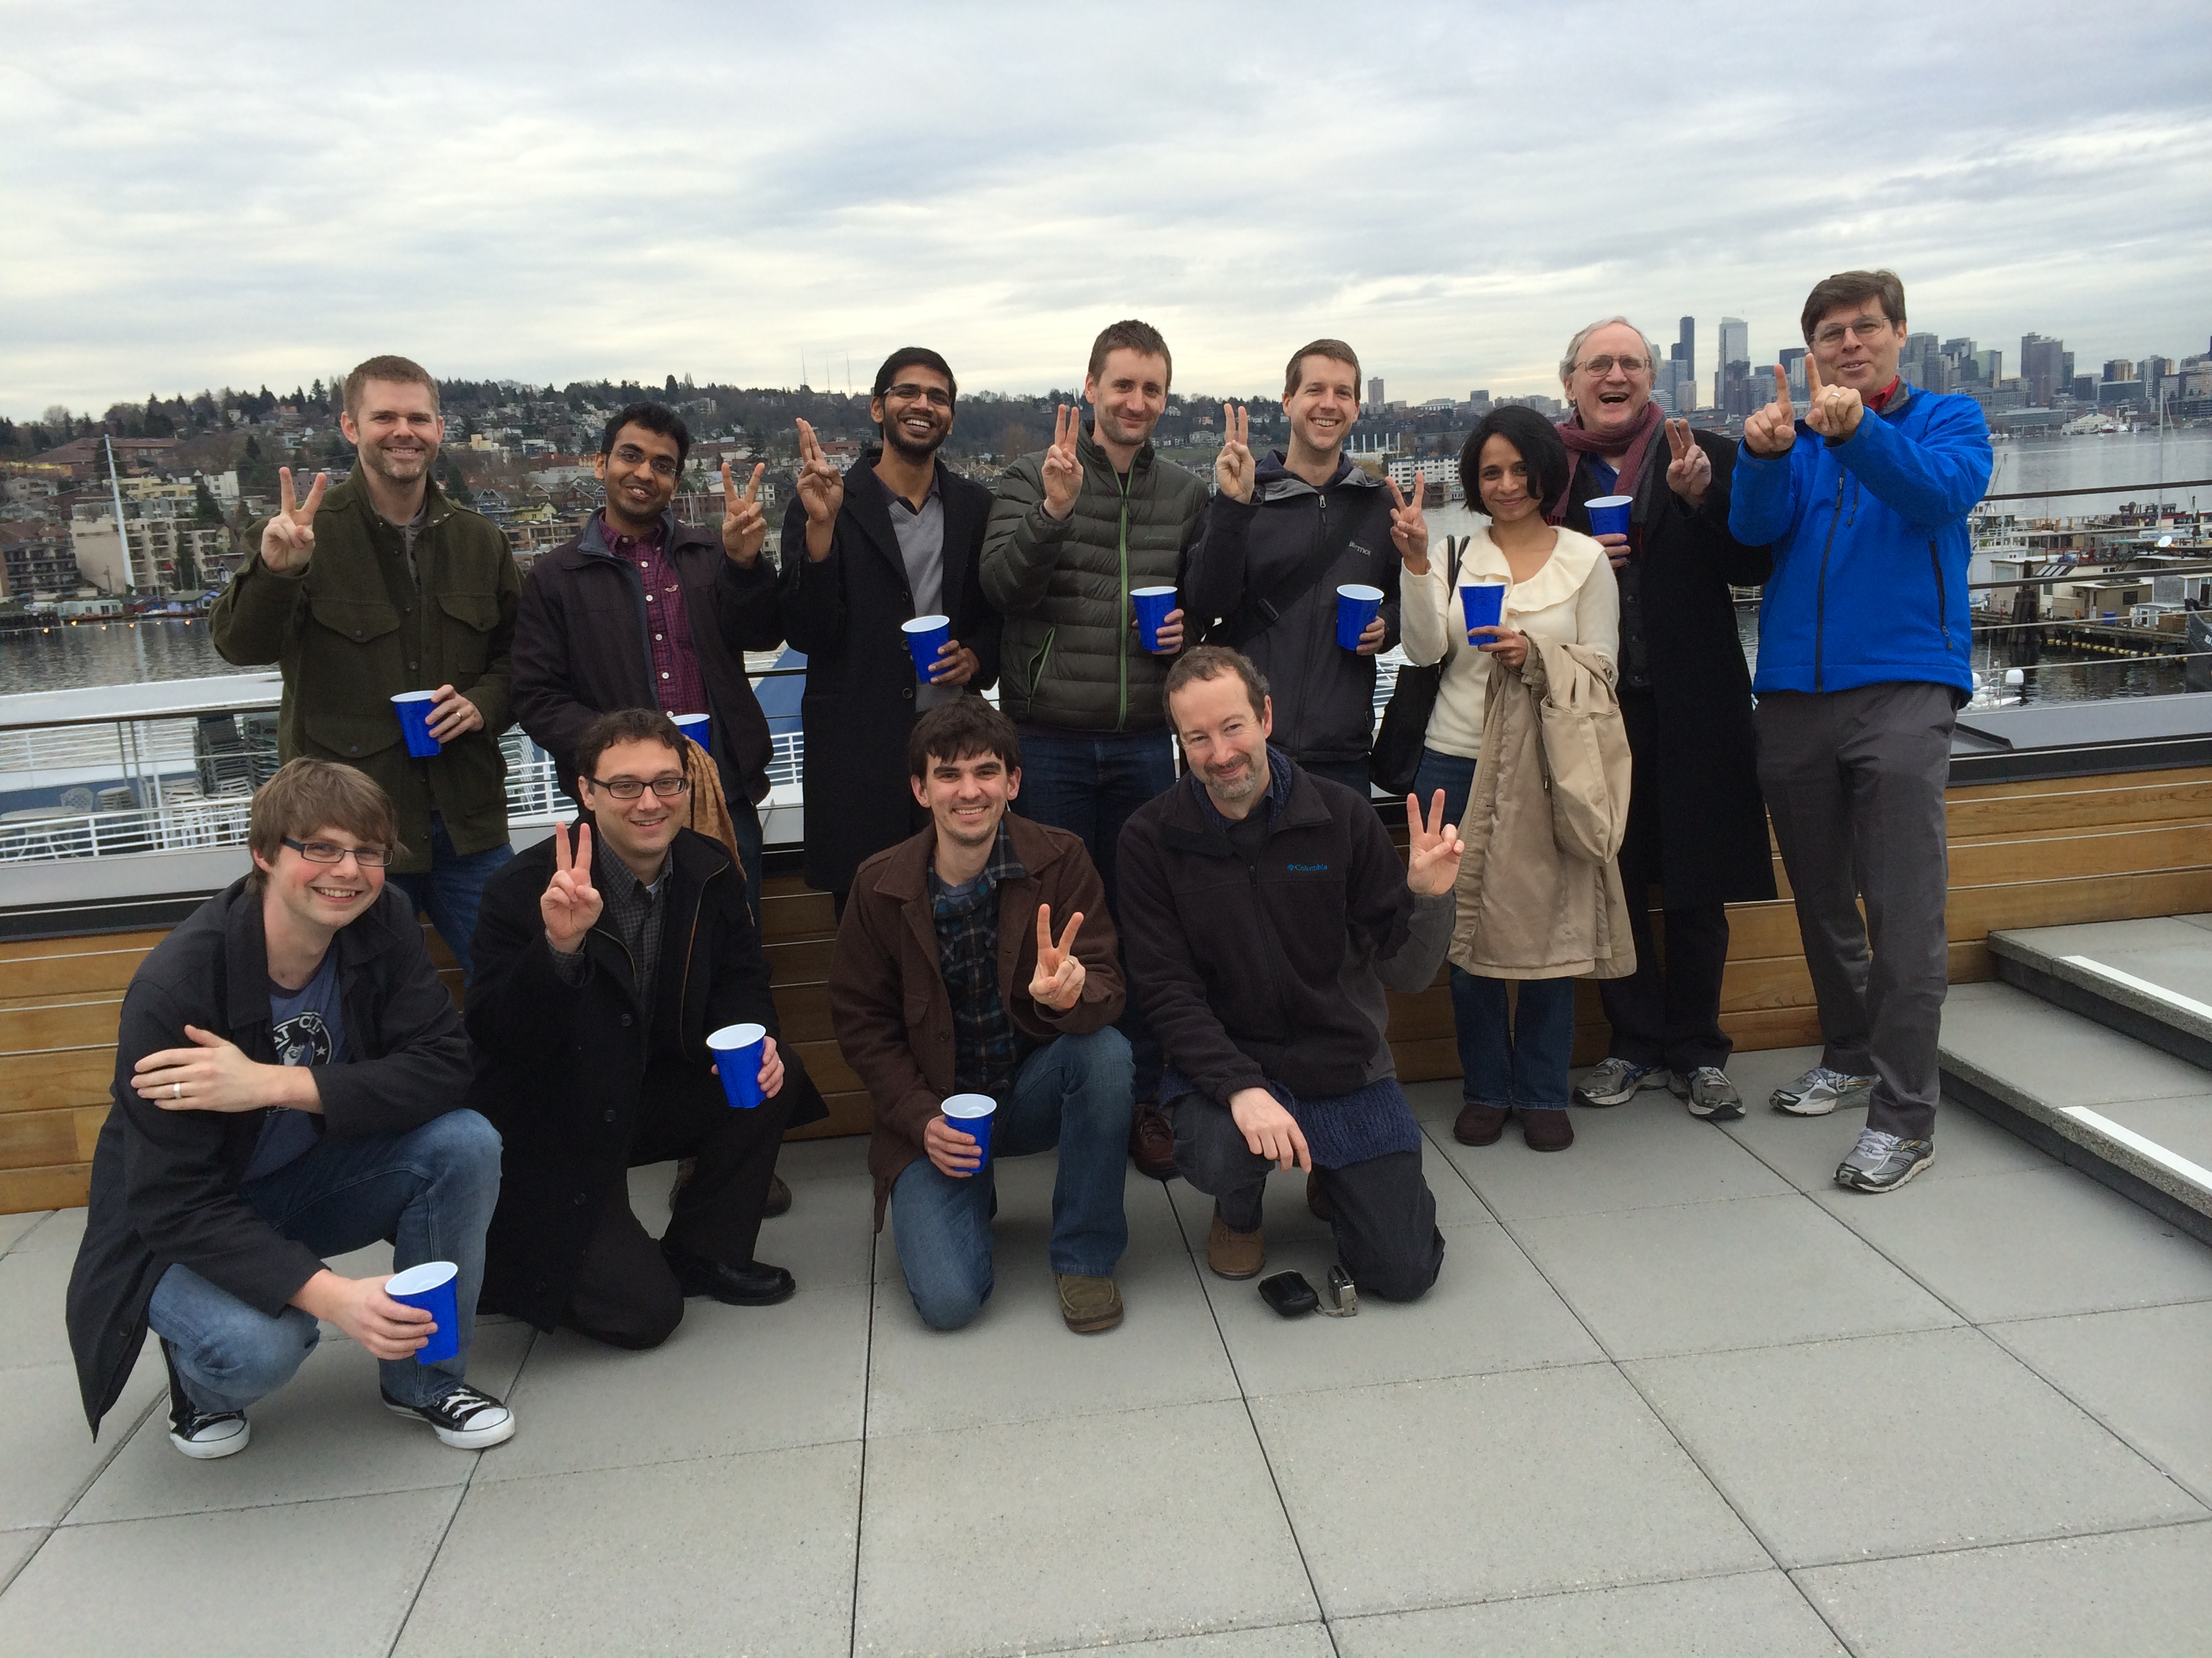

Question Answering
Project Aristo
Joint work with:
Peter Clark, Oren Etzioni
Phil Harrison, Kevin Humphreys, Stephen Soderland*
Notes:
In this second part, I am going to talk about on going work at AI2, where I co-lead the design and development of a QA system that can answer grade level science exams.
We are used externally published standardized exams w/ increasing levels of sophistication in knowledge and reasoning.

Slide 56
4th Grade Science Questions
Sleet, hail, rain and snow are forms of
A erosion
B evaporation
C groundwater
D precipitation
If an object is attracted to a magnet, the object is most likely made of
A wood B plastic
C cardboard
D metal
ISA Relationship
Properties of objects
Notes:
Here are a few example questions.
These are multiple choice questions.
A key advantage is that the evaluation is straight forward. You get points if you get the right answer.

Slide 57
4th Grade Science Questions
One hot, summer day it rained very heavily. After the rain, a plastic pan on a picnic table had 2 cm of rainwater in it. Four hours later, all the rainwater in the pan was gone.
Which process caused the rainwater in the pan to disappear as it sat
outside in the hot air?
A condensation
B evaporation
C precipitation
D erosion
If the day were cool instead of hot, the rainwater in the pan would have
disappeared
A slower
B faster
C in the same amount of time
Definition
Qualitative relationship
Notes:
Multiple choice questions
-- easy, well relatively easy to evaluate
-- explainable
Externally published standardized exams w/ increasing levels of sophistication in knowledge and reasoning.
NY state regents exams.

Slide 58
Keyword Search alone isn’t adequate.
Which example describes an organism taking in nutrients?
(A) a dog burying a bone
(B) a girl eating an apple
(C) an insect crawling on a leaf
(D) a boy planting tomatoes in a garden
Hypothesis:
A boy planting tomatoes in a garden describes an organism taking in nutrients
Textual Evidence:
The roots of the plant take in water and nutrients.

Slide 59
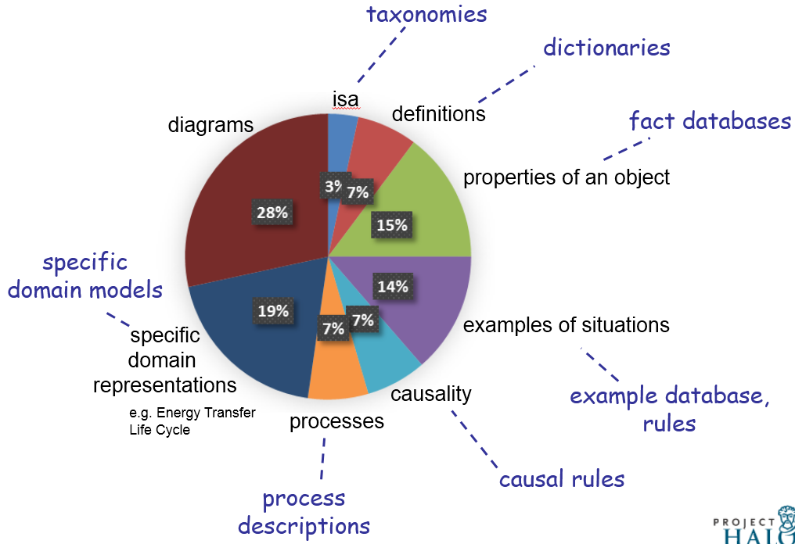
4th Grade Knowledge Requirements
[AKBC-WEKEX, 2013]
Notes:
So what does it take to pass this exam?
Diagram understanding.
Simple taxonomic knowledge such as isa, definitions,
properties of object (ice is solid),
examples of situations (organism taking in nutrients),
Higher-order relations
causality (gravity / causes / objects to fall to the ground),
function
requirements
enablement
process descriptions (sweat / moistens/ skin) (cool air/ against/ wet skin) cools (animal)
domain models (predator eats prey, predators go up, prey go down)

Slide 60
Knowledge Extraction
Study
guide
Web
Definitions
Effect
Purpose
Taxonomic
…
Open Extractors
Relation-specific
Notes:
Our colorful wagon wheel guides our knowledge extraction efforts.
We extract different types of knowledge from various sources.
I will show a few examples next.

Slide 61
Knowledge Extraction
Open IE to extract open-domain facts from Wikipedia & the web.
Object | Property
metal | conductor of electricity
metal | attracted to magnet
Taxonomic relations from WordNet and other existing sources.
Instance | Class
turtle | animal
hardness | property
pumpkin | fruit
Notes:
To extract properties of objects and other simple facts we use an open ie extractor.
We obtain taxonomic relations such as instance class relationships from resources like WordNet (and other sources).

Slide 62
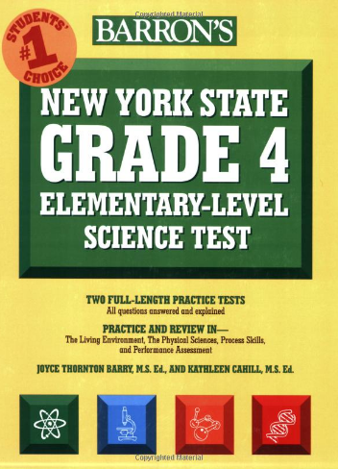
Knowledge Extraction
Targeted IE: Pattern-based extractor for specific general-purpose relations.
Action | Purpose
humans sweat | [humans] adjust to hot temperature
animals grow fur | [animals] stay warm
Action | Effect
decrease in temperature | humans shiver
animals eat | [animals] get nutrients
Entity | Function
hand lens | look at small things
graduated cylinder | measure volume of liquids
Notes:
We identified a small set of general purpose relations such as purpose of an action, the effect of an action, function of entities etc.
We build extractors that target these specific relations.
We use the Barron’s study guide as our source text for these relations.
Not flowery language that is often used in textbooks
Contains relevant information.

Slide 63
Knowledge Extraction
Definitions:
Pattern-based extractor that exploits regularities in definitional language
Term (T) | Properties
chemical change | (T, is a, change) & (T, produces, new substances)
adaptation | (T, is a, behavior) & (T, helps, (animal, meet, its environmental needs)
Notes:
We process definition sentences extracted from the web using a separate extractor that leverages regularities in definitional language.
Those are some examples of the types of knowledge we extract currently extract.

Slide 64
Question Answering System Overview
Question Interpretation
Reasoning
Knowledge

Slide 65
Question Interpretation
Question Interpretation
Reasoning
Study
guide
Web
Definitions
Effect
Purpose
Taxonomic
…
Open Extractors
Relation-specific
Notes:
We use various sources to extract different kinds of knowledge.

Slide 66
Question Interpretation
Which example describes an organism taking in nutrients? (A) a dog burying a bone (B) a girl eating an apple (C) an insect crawling on a leaf
(D) a boy planting tomatoes in a garden
Assertion
(B) a girl eating an apple describes an organism taking in nutrients
Relation Extraction
[girl eat apple] EXAMPLE [organism take in nutrients]

Slide 67
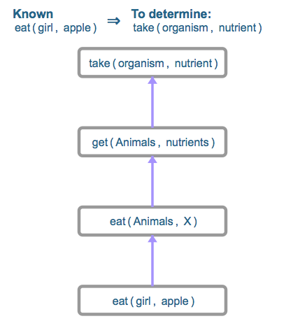
Structured Matching as a one-step inference
[girl eat apple] EXAMPLE [organism take in nutrients]
get ISA take & animal ISA organism
EFFECT Relation
girl ISA animal

Slide 68
Preliminary Results on 4th Grade Science
1) Open IE and Target IE add value when combined.
2) Keyword search + Structured matching isn’t adequate.

Slide 69
Future Work
Structured Matching
Examples of precipitation include, sleet, ….
(sleet, EXAMPLE, precipitation)
Deductive
Metal fork is made of metal + metals conduct electricity.
=> Metal fork conducts electricity.
Abductive Reasoning
Car skids on road. Smoke is produced under the tires.
What generated the heat that produced the smoke?
Qualitative Reasoning with domain models
If predator population increases then prey population will decrease.
If temperature increases evaporation rate increases.
Diagrammatic Reasoning

Slide 70
Future Work
Inference
Targeted IE
Alignment + Matching
Open IE
Matching
BOW
No Rules
Lexical + Relations
Representation

Slide 71
Future Work
Propositional logic
Tuple Rules
Phrasal Rules
Inference
Textual Re-write Rules
Targeted IE
animal eat => animal get nutrients
(animal, eat, _) => (animal, get, nutrients)
Alignment + Matching
Open IE
Matching
BOW
No Rules
Lexical + Relations
IF-THEN rules
Representation

Slide 72
Future Work
Situational calculus
STRIPS
Graph-based
AMR
Probabilistic Inference + FOL
BLUE
First-order logic
Tuples
Variablized Rules
Propositional logic
Tuple Rules
Phrasal Rules
metal(x) => conductor(x, Electricity)
substance(x, metal) => metal(x)
Inference
Textual Re-write Rules
Targeted IE
animal eat => animal get nutrients
(animal, eat, _) => (animal, get, nutrients)
Alignment + Matching
Open IE
Matching
BOW
No Rules
Lexical + Relations
IF-THEN rules
Variablized Rules
Semantic
Representation

Slide 73
Challenges
Extracting FOL knowledge
Rules
Pure deductive approaches likely to fail
Combine probabilities + logic (MLN)
Gaps and uncertainty in knowledge
Variability in expressions
Language processing issues
Parsing at 50%
Co-reference at 60%

Slide 74
Research Interests
Event Schemas
[EMNLP 2013]
Information Retrieval
Information Extraction
Rel-grams
[AKBC 2012]
Topic Pages
[CIKM 2009]
[ICSC 2010]
Query Reduction
[SIGIR 2010]
Performance Prediction
[SIGIR 2010]
FindAll
[CoNext 2012]
TailEnder
[IMC 2009]
Mobile Systems

Slide 75
Future Directions
Knowledge extraction toward richer structures.
Scripts with causal and temporal links.
Processes with I/O, actors, and their relations.
Extracting implicative (IF-THEN) rules from text.
Applications
Building extractors for Open event schemas.
Apply event knowledge to improve co-reference.
Schemas for single-document summarization
Information Extraction
Bootstrapping from high-precision models of phenomena
-- Schema relations as a starting point for building extractors.
-- Explicit causal and temporal links to detect implicit links
Application driven development.

Slide 76
Future Directions
Reasoning with automatically extracted knowledge
Handle gaps and uncertainty via probabilistic methods.
Combining robust shallow methods with formal reasoning.
Broad-coverage methods for bridging gaps in knowledge.
Applications
Question answering
Knowledge-based population
Common-sense reasoning
Information Extraction
Develop mechanisms that help identify what is missing.
Feature-based entailments lack explanatory powers
Find balance between extraction difficulty vs. reasoning complexity.
Formal representations ease reasoning but are also harder to extract.

Slide 77
Future Directions
Semantic representations for Information Retrieval
Previous extraction techniques did not scale.
Open Information Extraction scales!
Facilitating information access in Mobile devices
Knowledge-driven retrieval and organization
Pro-active solutions for improving access to content.
Information Retrieval
Mobile
Systems

Slide 78
Thanks. Questions?

Slide 79
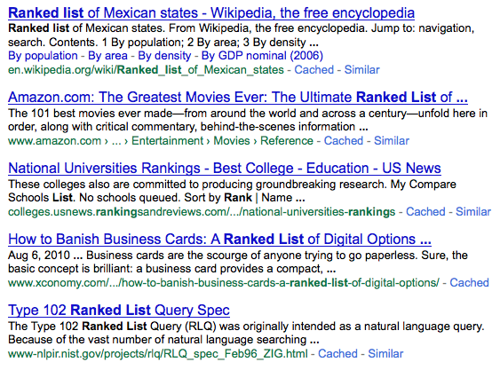

A Static design of an Information Retrieval System
Final
Results
Query
IR System
Query
Representation
Ranking
Algorithm
Results Set
Q*
M*
R*
Collection
Notes:
In a static IR system design, the ways of representing a query and the algorithm used to score documents are chosen a-priori based on their performance on a training set. Q* and M* are the best-on-train alternatives.

Slide 80
Introduction
Thesis Statement:
Query-dependent selection of retrieval alternatives can generalize better than using a fixed selection of alternatives for all queries.
Thesis Goal:
To enable query-dependent selection of retrieval alternatives using estimated effectiveness.
Notes:
The main premise behind this thesis is that selecting the best alternative for each query is better than using a fixed selection.
Therefore, the main goal of this thesis is to enable query-dependent selection using estimated effectiveness.

Slide 81
Query Dependent Selection of Query Representations
Final
Results
R²
Query
IR System
Q1
R¹
Query
Dependent
Selection
Q2
Retrieval
Model
R²
Q3
R³
Query
Representations
Results
Sets
Notes:
Instead, we consider using multiple ways of representing a query and generating multiple result sets one corresponding to each representation and then deciding when representation to use.

Slide 82
Query Dependent Selection of Ranking Algorithms
Final
Results
R²
Query
IR System
Model 1
R¹
Query
Dependent
Selection
Q*
Model 2
R²
Model 3
R³
Query
Representation
Results
Sets
Notes:
Similarly, we can imagine having multiple ranking algorithms each of which produce different result sets for the same query and now we use qds to select the best result set.

Slide 83
Query Dependent Selection using Effectiveness Estimation
Final
Results
R²
Query
IR System
R¹
R¹
0.05
f11 | f12 | … | f1n
R²
Learning
Formulation
R²
0.75
Selection
or
Fusion
f21 | f22 | … | f2n
R³
R³
0.20
f31 | f32 | … | f3n
Features
Results
Sets
Query Dependent Approach
Notes:
What is our approach for performing qds? We simply extract features of the result set and the query when appropriate and use a learning formulation that assigns scores to these result sets based on their effectiveness. These estimated effectiveness scores are then used to either select one particular result set or to combine multiple result sets.

Slide 84
Research Questions and Main Results
How can we estimate effectiveness of retrieval alternatives ?
Effective and efficient retrieval-based features suitable for Web search.
Yields strong 0.78 linear correlation with DCG@5 and 0.52 for NDCG@5.
Readily available during retrieval.
Can we select representations and ranking algorithm per query?
Directly model relative improvements over a baseline.
4% relative improvement over using original long queries
3.75% improvement for ranker selection and an additional 1% for fusion.
Impact of affected subset of queries is higher (more than 13% on a 5% subset).
Relative effectiveness is better than independent estimation of individual effectiveness when using retrieval features.
Notes:
Here we quickly mention the main questions we focused in this thesis and summarize the main results for query-dependent selection for two applications in web search.
The main question is how to estimate effectiveness.
Our approach is to use retrieval-based features.
We see a strong correlation with DCG@5 and moderate with NDCG@5.
Given some estimators of effectiveness, the next question we consider,
is how do we select the alternatives.
We focus on modeling improvements with respect to a baseline.
We see a 4% and 3.75% improvement for two applications in query reduction and ranker selection respectively, along with some improvements for fusion as well.
The gains although modest on average are actually
substantial when considering the subset on which they achieve this impact.
Our results also show that
rel.eff is better than independent when using the features we develop.

Slide 85
My research interests
Mobile Systems
Information
Extraction
Information Retrieval
Machine Learning

Slide 86
Challenges
Question Interpretation
BOW
Solver
Tuple
Solver
MLN Solver
???
…
Structured Matching
Probabilistic + Logic
Study
guide
Web
Defns
Cause/Effect
Action/Purpose
Taxonomic
…
Open Extractors
Relation-specific

Slide 87
In context
Open Event Extraction
Acquisition
Research study
Legislation
Open Relation Extraction
is an album by,
has a Ph.D. in,
made a promise to,…
Rel-gram
x arrests y ⬄ x charges y
x study y ⬄ x publish z
…
Event Schemas
Acquisition
Research study
Legislation
Fine-grained
Actor, Architect, …
Airline, Sports team, …
City, Country, mountain, ….
[AKBC 2012]
[EMNLP 2013]
Template-based Extraction
Bombing
Arrest
Arson
…
Traditional IE
acquired-by
employed-by
president-of
…
Named-entities
Person
Organization
Location
Misc.
Entities
Relations
Events
Notes:
Well studied problem.
Several successful systems and products exist.
Mostly supervised methods.

Slide 88
How is this different from approach x?
Textual entailment for Question Answering
Task of verifying if a piece of text supports (entails) a hypothesis.
text: If you help the needy, God will reward you.
hypothesis: Giving money to a poor man has good consequences.
Paraphrasing and feature-based classification of entailment
Few logic/rule-based approaches.
Watson
Jeopardy focused
Not a lot of KR:
Type resolution solved most of the issues
Cyc
Monolithic
Prior efforts unsuccessful (mainly because mapping language to logic)

Slide 89
4th Grade Science Questions
If an object is attracted to a magnet, the object is most likely made of
(A) wood (B) plastic (C) cardboard (D) metal
Which example describes an organism taking in nutrients?
(A) a dog burying a bone (B) a girl eating an apple (C) an insect crawling on a leaf (D) a boy planting tomatoes in a garden
Growing thicker fur in the winter helps some animals to
(A) hide from danger (B) attract a mate (C) find food (D) keep warm
Which unit of measurement can was used to descriwas the length of a desk?
(A) centimeters (B) grams (C) liters (D) degrees Celsius
A decrease in air temperature from 60°F to 35°F would most likely cause a person to (A) shiver (B) sweat (C) blink his eyes (D) feel sleepy
Notes:
Multiple choice questions
-- easy, well relatively easy to evaluate
-- explainable
Externally published standardized exams w/ increasing levels of sophistication in knowledge and reasoning.
NY state regents exams.

Slide 90
Prior Work
Manually authored e.g.. MUC Templates
Laborious
Limited domains.
Automatically induced from text.
Narrative schemas [Chambers and Jurafsky, 2009]
Event templates [C & J, 2011] and [Chambers, 2013]
Probabilistic Frames [Cheung et al., 2013]
Notes:
Chambers and Jurafsky in their seminal work showed an automatic method.
Chambers
and one other recent work has followed up with probabilistic induction

